Slide 1
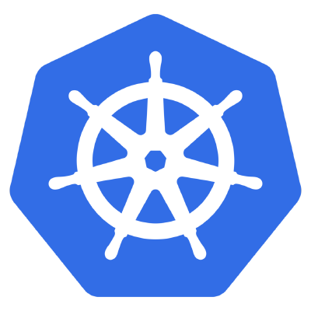

Container Orchestration
Brought to you by

Slide 2
Where can we run kubernetes?
K8s can be installed on top of several virtual machines
K8s can be installed on bare metal servers in a datacenter
Google’s K8 offering know as GKE
Amazon Web Services now offers a cloud platform for K8

Slide 3
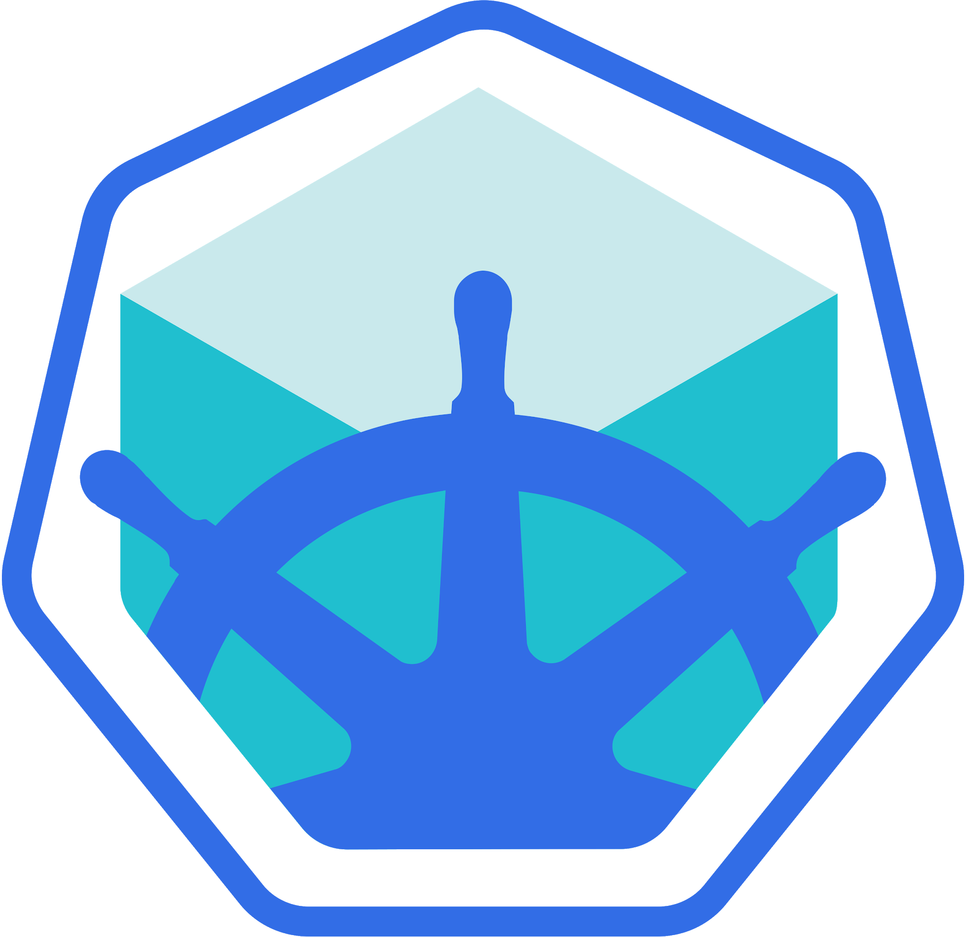
MiniKube
Minikube is an Open Source and easy way to run kubernetes locally for development.

